Slide 1
Session 2 on ‘Understanding, Analyzing and Generating Text’
Ashish Jain / 9888 570 759 / ashishjain1547@gmail.com

Slide 2
DISCUSSED PREVIOUSLY IN ‘SESSION 1’
○ What natural language processing (NLP) is
○ Why NLP is hard and only recently has become widespread ○ When word order and grammar is important and when it can be ignored ○ How a chatbot combines many of the tools of NLP ○ How to use a regular expression to build the start of a tiny chatbot
--
○ Tokenizing your text into words and n-grams (tokens)
○ Dealing with nonstandard punctuation and emoticons, like social media posts
○ Compressing your token vocabulary with stemming and lemmatization
○ Building a vector representation of a statement

Slide 3
NORMALIZING YOUR VOCABULARY (PART 1)
Why normalize our vocabulary:
1. To reduce the vocabulary size as vocabulary size is important to the performance of an NLP pipeline.
2. So that tokens that mean similar things are combined into a single, normalized form.
3. It improves the association of meaning across those different “spellings” of a token or n-gram in your corpus.
4. Reducing your vocabulary can reduce the likelihood of overfitting.
Vocabulary is normalized in the following ways:
a) CASE FOLDING (aka case normalization)
Case folding is when you consolidate multiple “spellings” of a word that differ only in their capitalization.
To preserve the meaning of proper nouns:
A better approach for case normalization is to lowercase only the first word of a sentence and allow all other words to retain their capitalization such as “Joe” and “Smith” in “Joe Smith”.
b) STEMMING
Another common vocabulary normalization technique is to eliminate the small meaning differences of pluralization or possessive endings of words, or even various verb forms. This normalization, identifying a common stem among various forms of a word, is called stemming. For example, the words housing and houses share the same stem, house. Stemming removes suffixes from words in an attempt to combine words with similar meanings together under their common stem. A stem isn’t required to be a properly spelled word, but merely a token, or label, representing several possible spellings of a word.
Stemming is important for keyword search or information retrieval. It allows you to search for “developing houses in Portland” and get web pages or documents that use both the word “house” and “houses” and even the word “housing.”

Slide 4
NORMALIZING YOUR VOCABULARY (PART 2)
# How does stemming affect precision and recall of a search engine?
This broadening of your search results would be a big improvement in the “recall” score for how well your search engine is doing its job at returning all the relevant documents. But stemming could greatly reduce the “precision” score for your search engine, because it might return many more irrelevant documents along with the relevant ones. In some applications this “false-positive rate” (proportion of the pages returned that you don’t find useful) can be a problem.
So most search engines allow you to turn off stemming and even case normalization by putting quotes around a word or phrase. Quoting indicates that you only want pages containing the exact spelling of a phrase, such as “‘Portland Housing Development software.’”
That would return a different sort of document than one that talks about a “‘a Portland software developer’s house’”.
c) LEMMATIZATION
If you have access to information about connections between the meanings of various words, you might be able to associate several words together even if their spelling is quite different. This more extensive normalization down to the semantic root of a word—its lemma—is called lemmatization.

Slide 5
# Lemmatization and it’s use in the chatbot pipeline:
Any NLP pipeline that wants to “react” the same for multiple different spellings of the same basic root word can benefit from a lemmatizer. It reduces the number of words you have to respond to, the dimensionality of your language model. Using it can make your model more general, but it can also make your model less precise, because it will treat all spelling variations of a given root word the same.
For example, “chat,” “chatter,” “chatty,” “chatting,” and perhaps even “chatbot” would all be treated the same in an NLP pipeline with lemmatization, even though they have different meanings.
Likewise, “bank,” “banked,” and “banking” would be treated the same by a stemming pipeline, despite the river meaning of “bank,” the motorcycle meaning of “banked,” and the finance meaning of “banking.”
Lemmatization is a potentially more accurate way to normalize a word than stemming or case normalization because it takes into account a word’s meaning. A lemmatizer uses a knowledge base of word synonyms and word endings to ensure that only words that mean similar things are consolidated into a single token.

Slide 6
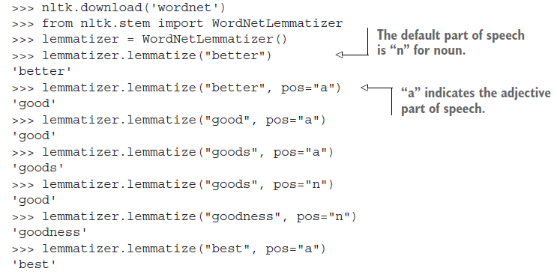
# Lemmatization and POS (Part of speech) Tagging
Some lemmatizers use the word’s part of speech (POS) tag in addition to its spelling to help improve accuracy.
The POS tag for a word indicates its role in the grammar of a phrase or sentence. For example, the noun POS is for words that refer to “people, places, or things” within a phrase. An adjective POS is for a word that modifies or describes a noun. A verb refers to an action. The POS of a word in isolation cannot be determined. The context of a word must be known for its POS to be identified.
So some advanced lemmatizers can’t be run-on words in isolation.
>>> import nltk
>>> nltk.download('wordnet')
>>> from nltk.stem import WordNetLemmatizer
>>> lemmatizer = WordNetLemmatizer()
>>> lemmatizer.lemmatize("better")
'better’
>>> lemmatizer.lemmatize("better", pos="a")
'good’
>>> lemmatizer.lemmatize("goods", pos="n")
'good’
>>> lemmatizer.lemmatize("goods", pos="a")
'goods’
>>> lemmatizer.lemmatize("good", pos="a")
'good’
>>> lemmatizer.lemmatize("goodness", pos="n")
'goodness'
>>> lemmatizer.lemmatize("best", pos="a")
'best'

Slide 7
IN THE NEXT FEW SLIDES, WE WILL BE PLAYING AROUND WITH A SENTIMENT ANALYSIS PACKAGE CALLED VADER.
# VADER: for Valence Aware Dictionary for sEntiment Reasoning.
# VADER is a rule-based approach towards doing sentiment analysis.
# As of NLTK version 3.6 [20210721], it uses VADER for sentiment analysis.

Slide 8
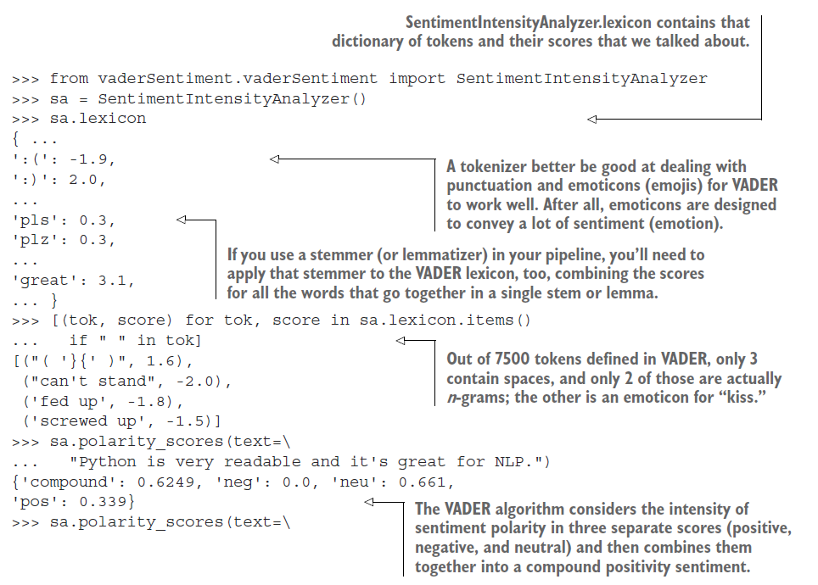

Slide 9
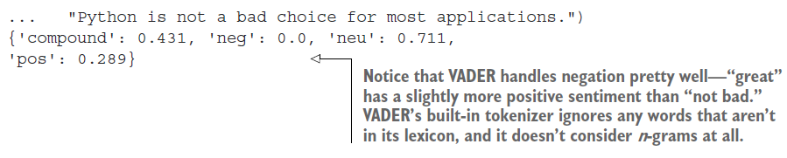
DRAWBACK OF VADER
The drawback of VADER is that it doesn’t look at all the words in a document, only about 7,500.
What if you want all the words to help add to the sentiment score?
And what if you don’t want to have to code your own understanding of the words in a dictionary of thousands of words or add a bunch of custom words to the dictionary in SentimentIntensityAnalyzer.lexicon?
The rule-based approach might be impossible if you don’t understand the language, because you wouldn’t know what scores to put in the dictionary (lexicon)!

Slide 10
Thank you!

